Slide 1

Advanced Visualization

Slide 2
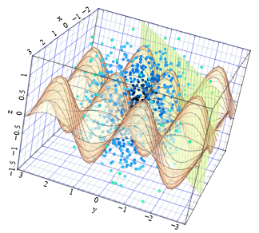
Agenda
Today we will be focusing on plotting and on how to produce publication-ready plots
Modifying your matplotlibrc file
Matplotlib Style sheets
Seaborn
Bokeh

Slide 3
Modifying your matplotlibrc file
Matplotlib uses a special file called matplotlibrc file. This file is usually in your ~/.matplotlib/matplotlibrc
You can check the location of this file by typing:
# Importing modules
%matplotlib inline
import matplotlib
# Printing out `fname` for `matplotlibrc` matplotlib.matplotlib_fname()
import numpy as np
import matplotlib.pyplot as plt

Slide 4
Modifying your matplotlibrc file
You can also edit the different parameters of the matplotlibrc file.
# List of possible values to be changed
import matplotlib as mpl matplotlib.rcParams
print('Linewidth: {0} Color: {1}'.format( mpl.rcParams['lines.linewidth’], mpl.rcParams['lines.color’]))
# Changing line properties mpl.rc('lines', linewidth=10, color='g') print('Linewidth: {0} Color: {1}'.format( mpl.rcParams['lines.linewidth'], mpl.rcParams['lines.color']))

Slide 5
Matplotlib Style sheets
Newer versions of matplotlib offer the option to setup a style sheet. For example, one can have a plot look like taken from ggplot or SuperMongo.
def plotting(stylename='classic’):
# Defining data
x = np.arange(0,10)
y = np.random.randint(20,30,x.size)
# Defining style sheet
try: plt.style.use(stylename)
except IOError:
msg = '{0} not found'.format(stylename)
raise IOError(msg) # Plotting plt.clf() plt.plot(x,y,'-ro', label=stylename) plt.xlabel('X label’); plt.ylabel('X label’); plt.legend(loc=1)
plt.title('Plot using "{0}" Style'.format(stylename), fontsize=20 )
plt.show()

Slide 6
Matplotlib Style sheets
Try these out:
plotting(stylename='classic’)
plotting(stylename='ggplot')
for style in plt.style.available[0:5]:
plotting(stylename=style)
plt.style.available

Slide 7

Seaborn

Slide 8
Seaborn
import matplotlib
import matplotlib.pyplot as plt
import numpy as np
import pandas as pd
%matplotlib inline
import seaborn as sns
sns.set_style('darkgrid')

Slide 9
Reading in the data
# Names of columns
names = [ 'mpg' , 'cylinders' , 'displacement' , 'horsepower' , 'weight’ , 'acceleration' , 'model_year' , 'origin' , 'car_name’ ]
# reading in ASCII file with motor data
df = pd.read_csv("http://archive.ics.uci.edu/ml/machine-learning-databases/auto-mpg/auto-mpg.data", sep='\s+', names=names)

Slide 10
Reading in the data
# Creating new column named `maker`
df['maker'] = df.car_name.map(lambda x: x.split()[0])
# Assiging Continents corresponding values
df.origin = df.origin.map({1: 'America', 2: 'Europe', 3: 'Asia’})
# Dropping `NaN` values
df=df.applymap(lambda x: np.nan if x == '?' else x).dropna()
# Changing the data type of `horsepower`
df['horsepower'] = df.horsepower.astype(float)
df.head()

Slide 11
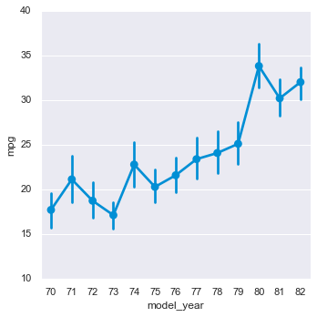
catplot and FacetGrid
sns.set_context('notebook’)
sns.catplot(data=df,
x="model_year",
y="mpg")

Slide 12
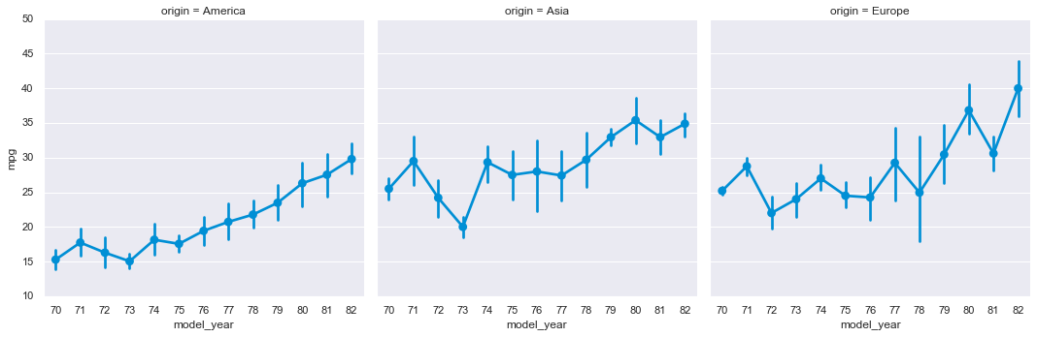
catplot and FacetGrid
We can start off by visualizing 'model_year' vs 'mpg' for each type of 'origin' class.
We can do this by using the catplot command:
sns.catplot(data=df, x="model_year", y="mpg", col="origin")

Slide 13
catplot and FacetGrid
You can easily change the type of graph that you're plotting
g = sns.FacetGrid(df, col="origin")
g.map(sns.histplot, "mpg")
store the plot
now call it and map it to new column
Makes grid of subplots where each subplot shows the distribution of the "mpg" values for different values in the "origin" column of your df

Slide 14
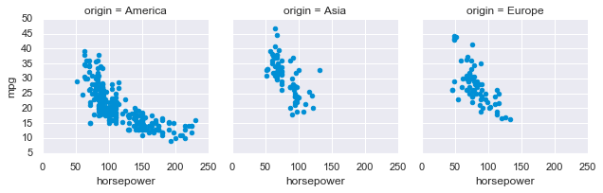
catplot and FacetGrid
How about we look at a scatter plot of the data
g = sns.FacetGrid(df, col="origin")
g.map(plt.scatter, "horsepower", "mpg")

Slide 15
catplot and FacetGrid
Let's say you want to visualize the "Kernel Density Estimation" for each type
# Define new variable `tons`
df['tons'] = (df.weight/2000).astype(int)
# Create grid to plot your data
g = sns.FacetGrid(df, col="origin", row="tons")
# 1) Specify type of function 2) Specify 'x' and 'y' for each plot
g.map(sns.kdeplot, "horsepower", "mpg")
# Define the x- and y-limits for each subplot
plt.xlim(0, 250) plt.ylim(0, 60)

Slide 16
pairplot and PairGrid
These functions allow you to plot pairwise relations in a dataset. Let's say we want to plot the relation between mpg, horsepower, weight, and origin. And we also want to separate them based on the origin.
No types
g = sns.PairGrid(df[["mpg", "horsepower", "weight", "origin"]])
g.map_upper(sns.regplot)
g.map_lower(sns.residplot) g.map_diag(plt.hist)
for ax in g.axes.flat:
plt.setp(ax.get_xticklabels(), rotation=45) g.set(alpha=0.5)

Slide 17
pairplot and PairGrid
We can specify the types of origin
g = sns.PairGrid(df[["mpg", "horsepower", "weight", "origin"]], hue="origin")
g.map_upper(sns.regplot)
g.map_lower(sns.residplot)
g.map_diag(plt.hist)
for ax in g.axes.flat:
plt.setp(ax.get_xticklabels(), rotation=45) g.add_legend() g.set(alpha=0.5)

Slide 18
pairplot and PairGrid
We can specify the types of maker
g = sns.PairGrid(df[["mpg", "horsepower", "weight", "origin"]], hue=”maker")
g.map_upper(sns.regplot)
g.map_lower(sns.residplot)
g.map_diag(plt.hist)
for ax in g.axes.flat:
plt.setp(ax.get_xticklabels(), rotation=45) g.add_legend() g.set(alpha=0.5)

Slide 19
pairplot and PairGrid
You can see, you have some freedom when it comes to what you want to plot
g = sns.PairGrid(df[["mpg", "horsepower", "weight", "origin"]])
g.map_diag(sns.kdeplot)
g.map_offdiag(sns.kdeplot, cmap="Blues_d", n_levels=6)

Slide 20
jointplot and JointGrid
You can also visualize 2D-data in different ways:
KDE and Histograms
You can estimate the Pearson correlation factor, along with the p-value of a linear fitting.
sns.jointplot(data=df, x="mpg", y="horsepower", kind='kde')
g = sns.jointplot(x="mpg", y="horsepower", data=df, kind="kde", color="r") g.plot_joint(plt.scatter, c="w", s=30, linewidth=1, marker="+") g.ax_joint.collections[0].set_alpha(0)
Matplotlib!

Slide 21
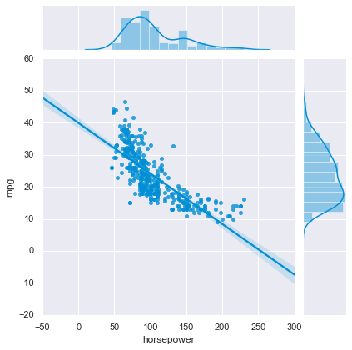
jointplot and JointGrid
show the linear regression of data
sns.jointplot("horsepower", "mpg", data=df, kind="reg")

Slide 22
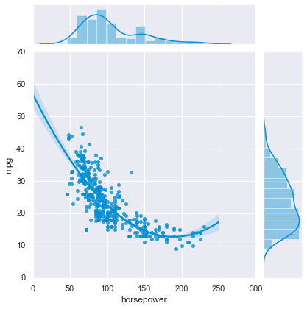
jointplot and JointGrid
2nd-order fitting to the data:
g = sns.JointGrid(x="horsepower", y="mpg", data=df) g.plot_joint(sns.regplot, order=2)
g.plot_marginals(sns.histplot)

Slide 23
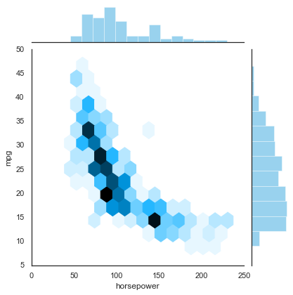
jointplot and JointGrid
You can also plot 2D-Histograms
used for resource management and exception handling.
with sns.axes_style("white"):
sns.jointplot(x="horsepower", y="mpg", data=df, kind="hex");

Slide 24
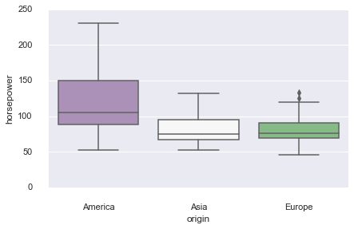
boxplot
sns.boxplot(x="origin", y="horsepower",data=df, palette="PRGn") sns.despine(offset=10, trim=True)

Slide 25
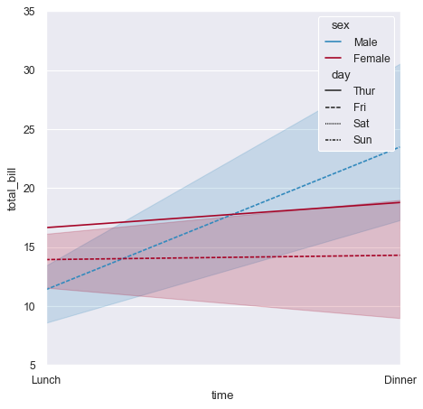
tsplot
Plot one or more timeseries with flexible representation of uncertainty.
tips = sns.load_dataset(”tips")
ax = sns.lineplot(x="time", y="total_bill",
hue="sex", style="day",
data=tips)
fig = plt.figure(figsize=(#,#))

Slide 26
tsplot
x = np.linspace(0, 15, 31)
data = np.sin(x) + np.random.rand(10, 31) + np.random.randn(10, 1)
ax = sns.lineplot(data=data)

Slide 27
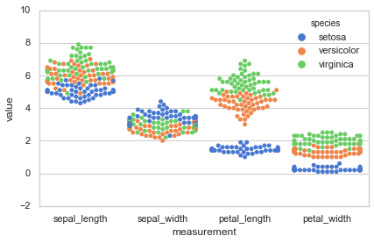
Scatterplot
Let’s use the IRIS dataset
sns.set(style="whitegrid", palette="muted")
# Load the Dataset
iris = sns.load_dataset("iris")
# Create a boxplot
iris = pd.melt(iris, "species", var_name="measurement")
# Draw a categorical scatterplot to show each observation sns.swarmplot(x="measurement", y="value", hue="species", data=iris)

Slide 28
Heatmaps
Let’s use the IRIS dataset
REMINDER to check documentation,
Here we can use .set to setup our plot using multiple arguments
sns.set(context="paper", font="monospace")
# Load the datset of correlations between cortical brain networks
df = sns.load_dataset("brain_networks", header=[0, 1, 2], index_col=0) corrmat = df.corr()

Slide 29
Heatmaps
Let’s use the Brain-Networks dataset
# Set up the matplotlib figure
f, ax = plt.subplots(figsize=(12, 9))
# Draw the heatmap using seaborn
sns.heatmap(corrmat, vmax=.8, square=True)
# Use matplotlib directly to emphasize known networks
networks = corrmat.columns.get_level_values("network")
for i, network in enumerate(networks):
if i and network != networks[i - 1]:
ax.axhline(len(networks) - i, c="w")
ax.axvline(i, c="w")
f.tight_layout()

Slide 30
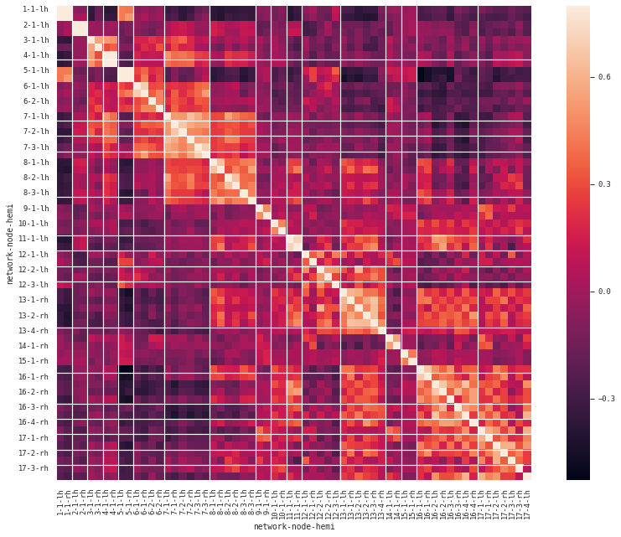
Heatmaps

Slide 31
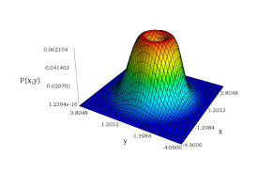
End
Happy computing!

Slide 32
